Slide 1
AR Indoor Navigation for
SKKU Suwon campus
team E: 김현호 마준서 안정민 조민구

Slide 2
Review: Steps for AR Indoor Navigation
1/11
Mapping
Indoor Positioning
Navigating
-Custom map for navigation
-Set data about core location
-Identify user’s position
-Check starting point & Error correction
-Navigation algorithm
-UI/UX for AR environment
-Extra function

Slide 3
Review: Steps for AR Indoor Navigation
1/11
Mapping
Indoor Positioning
Navigating
-Custom map for navigation
-Set data about core location
-Identify user’s position
-Check starting point & Error correction
-Navigation algorithm
-UI/UX for AR environment
-Extra function

Slide 4
Review: Steps for AR Indoor Navigation
1/11
Mapping
Indoor Positioning
Navigating
-Custom map for navigation
-Set data about core location
-Identify user’s position
-Check starting point & Error correction
-Navigation algorithm
-UI/UX for AR environment
-Extra function

Slide 5
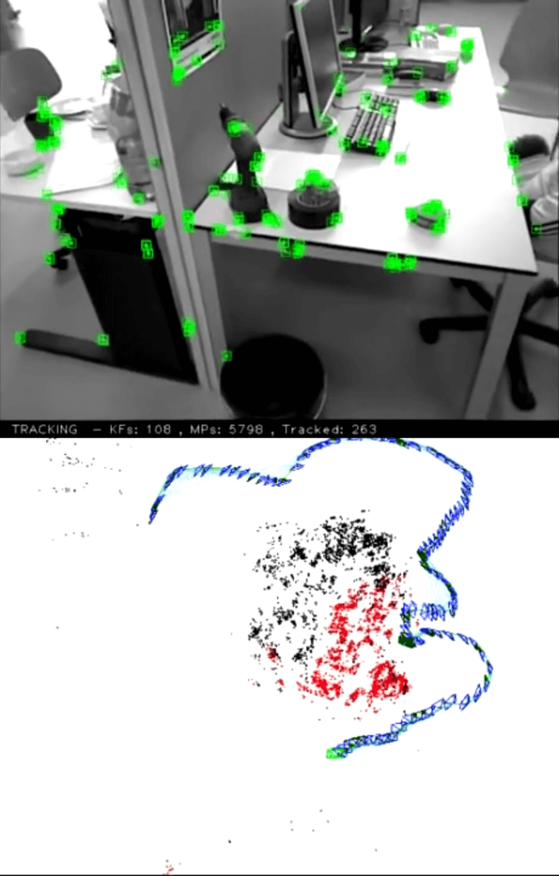
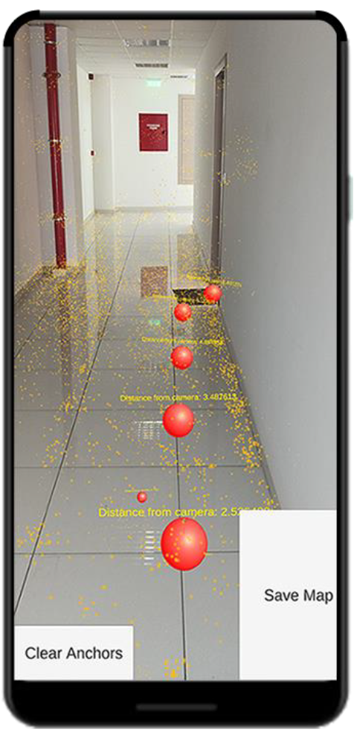



Mapping
2/11
Feature Based Mapping
-Detect feature with
LiDAR/Camera Sensor
-Can be used for both localization and mapping
-Might be expensive(for us)
ORB-SLAM video
(by Raúl Mur Artal)
An AR INDOOR POSITIONING SYSTEM Based on ANCHORS(2020)

Slide 6
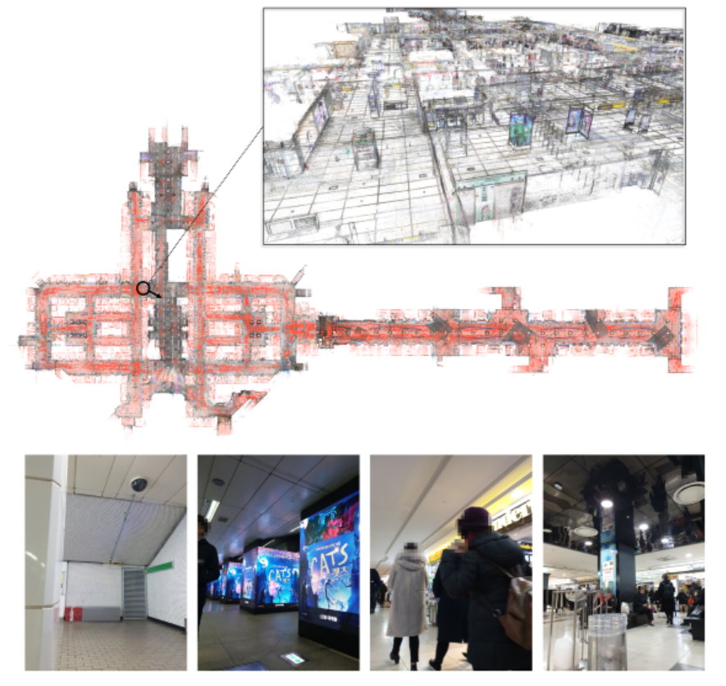
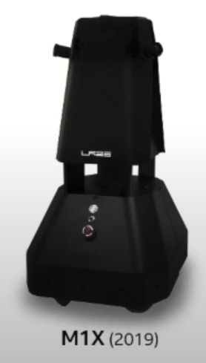
Mapping
2/11
Feature Based Mapping
-Detect feature with
LiDAR/Camera Sensor
-Can be used for both localization and mapping
-Might be expensive(for us)
NAVER LABS Localization Datasets

Slide 7
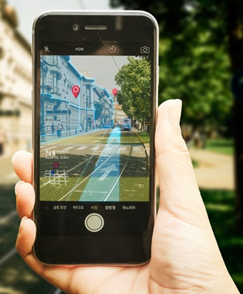
Mapping
2/11
AR Anchoring
-Enables comparing the “landmark” data to data being received from camera to find current location
(Virtual Positioning System)
-Enable the user to see the destination by trilateration process

Slide 8
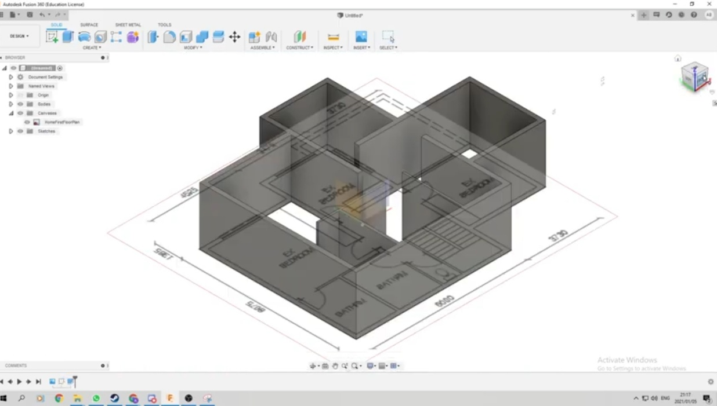
Mapping
3/11
Model Based Mapping
-Create a virtual map that fits the distance of real space
-Inaccurate mapping can cause errors in navigation
-Easy to edit
Virtual Model Based on floor plan

Slide 9
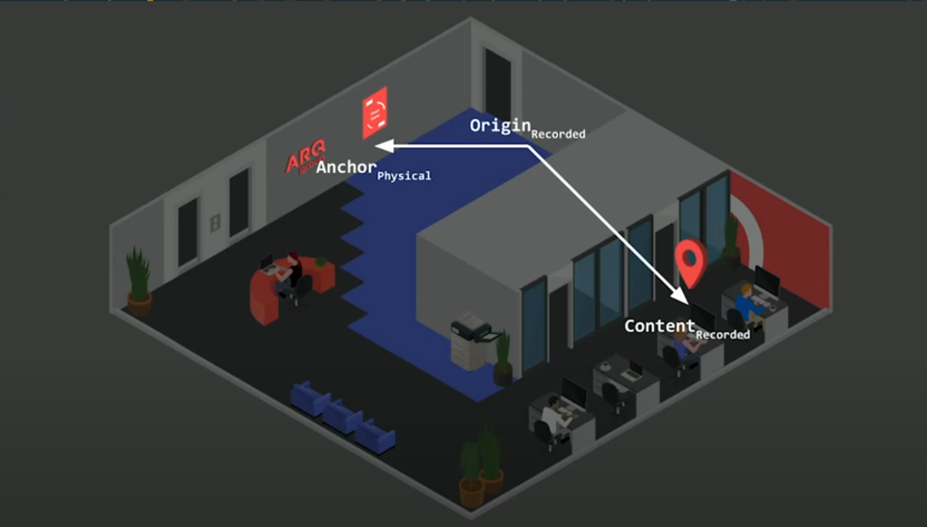

Indoor Positioning
4/11
Indoor Navigation with ARCore(GDG DevFest, 2018)

Slide 10
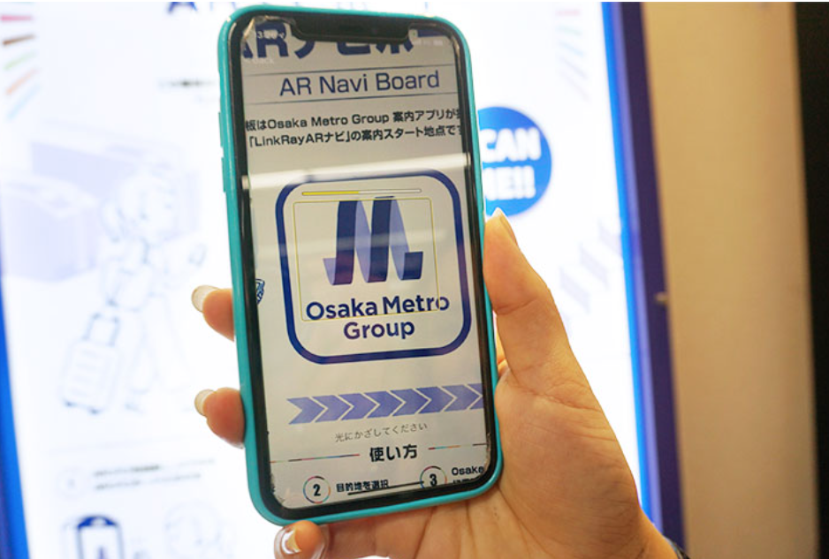
Indoor Positioning
4/11
AR Marker
-Characteristically easier to recognize than the surrounding environment(QR code, signboard)
-Many saved markers can decrease recognize performance
AR Navi Board(Osaka Metro Group)

Slide 11
Indoor Positioning
5/11
Vision based(Markerless)
-Estimate location based on feature of camera image
-Static and large object(plane, wall, window, door) and point cloud can be helpful
-Affected by the lighting environment
Wi-fi based
-Using the radio frequency (RF) patterns, Received Signal Strength Indication(RSSI), fingerprint of Wi-Fi access points
-Use existing Wi-Fi infrastructure and requires no additional hardware deployment

Slide 12
Indoor Positioning
6/11
What places should be recognized in our APP?
Starting point
Most of them are probably rooms/ entrances
The campus rooms have a door-plates to recognize as a markers
AR Marker
(+Image recognition & GPS filtering)
Crossroad(or other core spot)
The Smartphone’s gravity & accel sensor detects the movement, but errors continue to occur
Through core spot recognition, we will able to re-localization and error correction
AR cloud point, Wi-fi base, Algorithm etc…

Slide 13
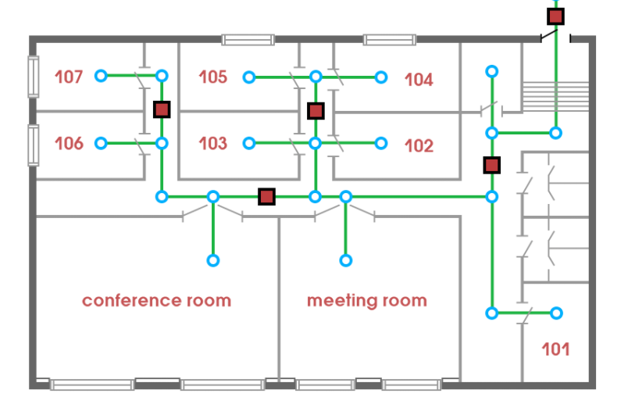
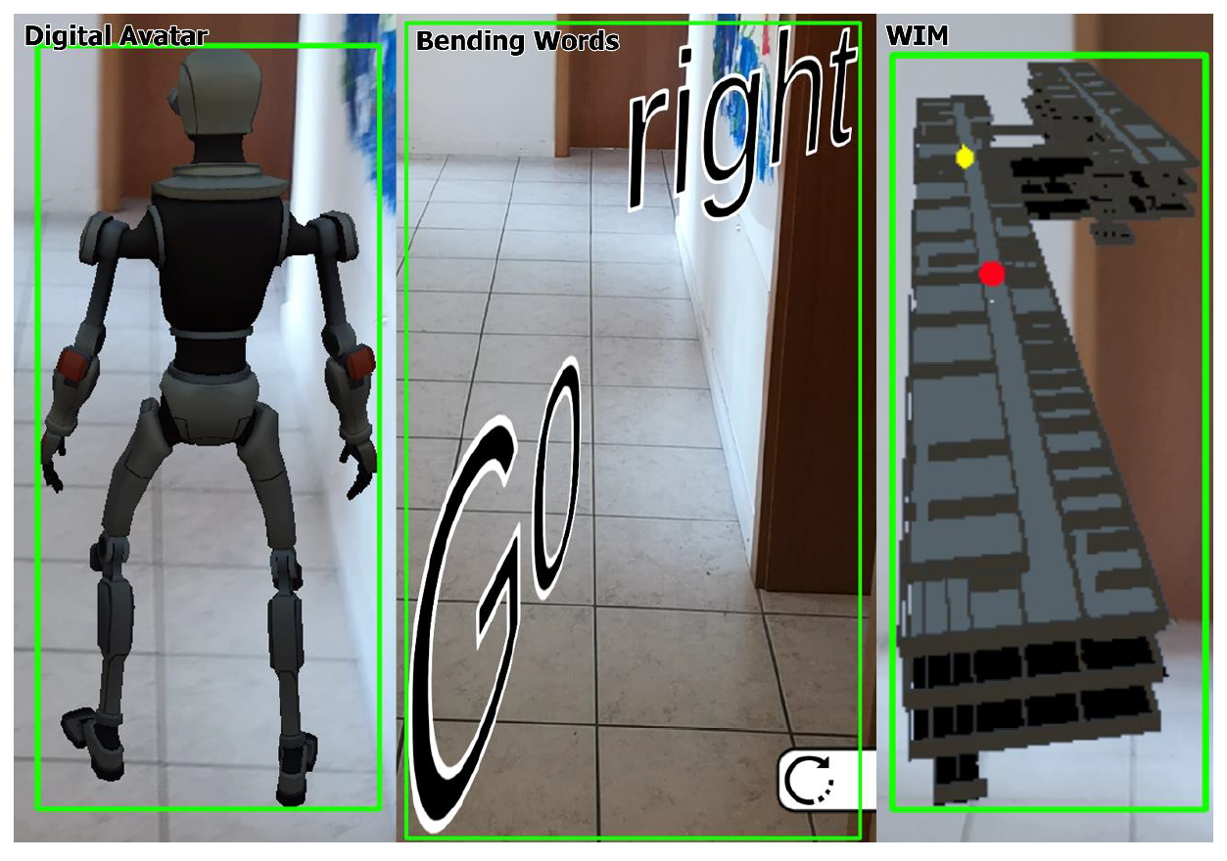
Navigate(Algorithm, UI/UX)
7/11
Navigation Graph(mobidev)
Overcoming the problem of uncertain tracking errors in an AR navigation application(2020)

Slide 14

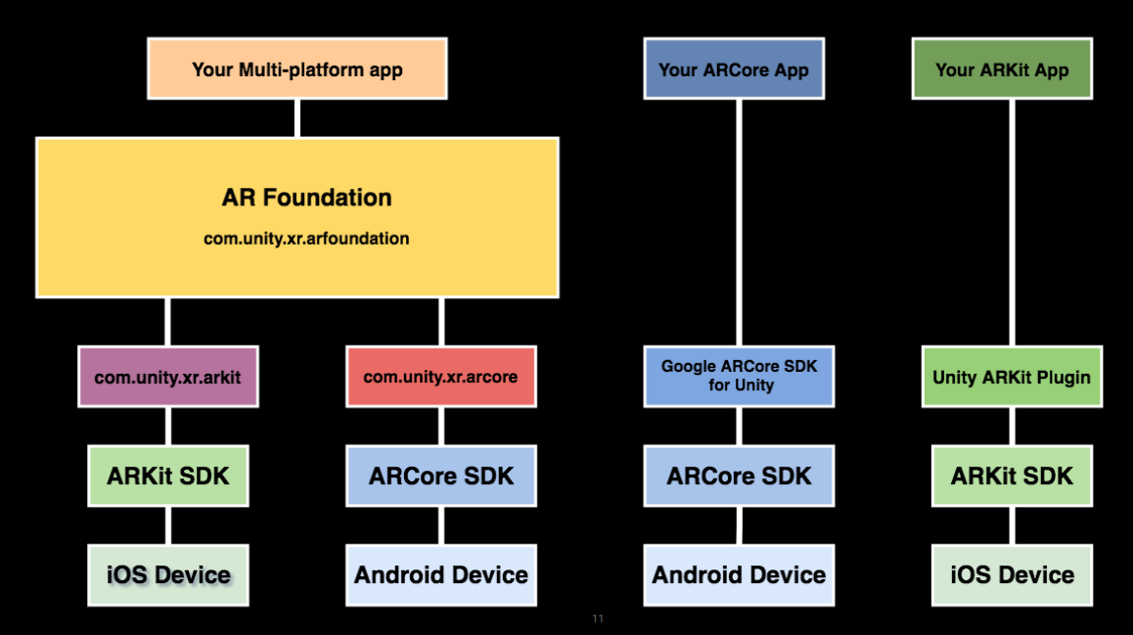
AR Environment
8/11

Slide 15
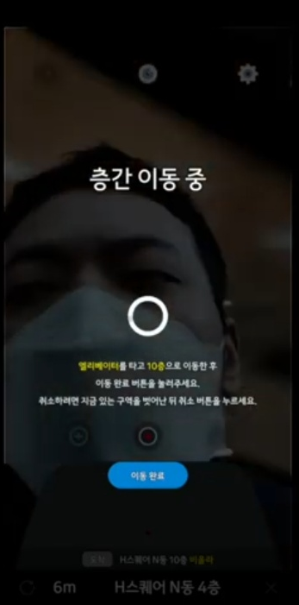
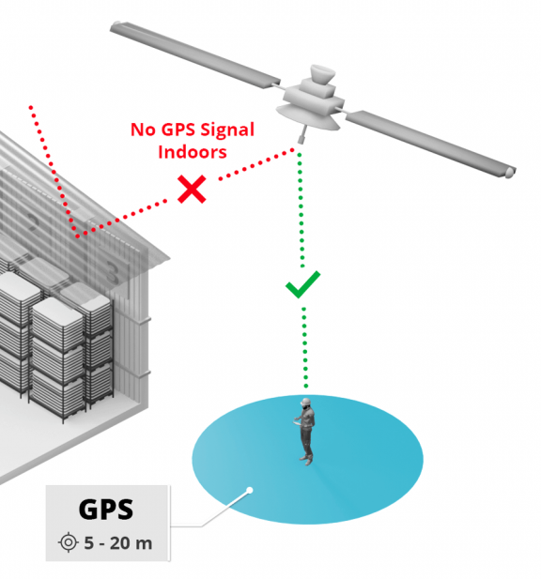
Feedback Reflection
9/11
1.Floor recognition
2.Is ‘Indoor’ recognizable without gps?
3.Cost-effectiveness of technology

Slide 16
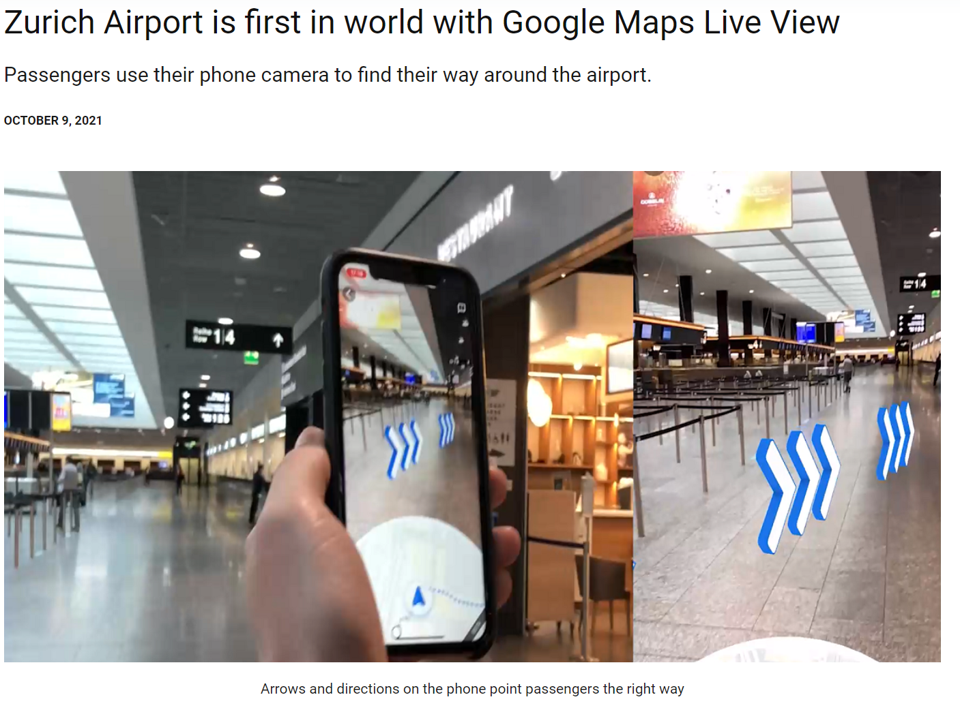
Feedback Reflection
9/11
1.Floor recognition
2.Is ‘Indoor’ recognizable without gps?
3.Cost-effectiveness of technology

Slide 17
Project Role & Project Expansion
10/11
Challenge
1.Better performance
2.Connection buildings and outdoor navigation by GPS
3.Auto map generating from floor plan
AR Development & Mapping | 마준서
AR marker recognition | 안정민, 조민구
Vision based localization | 김현호, 안정민
Location error correction | 김현호
Navigation algorithm | 조민구
Data management | 조민구
Create app flow, UI/UX | 마준서

Slide 18
Q&A
11/11

